Slide 1
Project Scheduler Web App: Final
By: Jason Byrne

Slide 2
Overview
Motivation Behind Project
Initial Requirements and Stretch Goals
Modified Requirements and Stretch Goals
Tools Used
Database Design
Workflow
Testing
Demo of Website
Evaluation of Requirements and Stretch Goals
Project Analytics
Review
Notes:
Initial requrements then modified requirements and if I achieved them.

Slide 3
Motivation Behind Project
Data is Currently Organized Using a Spreadsheet
Pros and Cons for Spreadsheet Application:
Pro: Does the job
Con: Usability and Capabilities are Limited
Project Idea:
Application for Organizing Project Information and Presentation Timeline
Easy to Use with Simple Design
Notes:
Before I decided my project and throughout this whole semester, we were using a excel spreadsheet to organize all the teams information. It did the job, but would work better if designed specifically for this class. This is where I came up with the idea to create an application that would store and organize all the teams information and have a easier way to input data. For usability, I would make it easy to use and have it behave as one would expect.

Slide 4
Initial Requirements
Be able to schedule first, second, and final presentation
Have limitation for number of students that can present each date. ex 5
Have a way to provide link to github repository
Way to upload advertisements for final presentation
Presentations are emailed to front office also ~csoffice@cs.ksu.edu
Possible user registration for authentication and start with shadow password

Slide 5
Modified Requirements
Initially Implement for Admin Use
Quality of Life Improvements:
Dropdown List of Advisors
Date Picker for Presentations,
Able to Mark Presentations as Complete,
Easy to Add/Remove Students to/from Teams

Slide 6
Initial Stretch Goals
Drag and drop ability to make it easier to create teams
Drop down list of all possible advisors
Prompting tool to get students going
Auto send email if not done in certain timeframe
Mobile access to web app

Slide 7
Modified Stretch Goals
User Registration for Students
Students can Request/Make Changes for Their Team’s Information

Slide 8





Tools Used
https://www.zdnet.com/article/has-the-time-finally-come-for-postgresql/
https://www.djangoproject.com
https://www.g2.com/products/pycharm/reviews
https://www.pgadmin.org/
https://www.python.org/
Notes:
I chose to use django as my development framework which utilizes python and postgresql for the database tool because that was what Mr. Nielsen recommended and I decided to go with it. Django high-level Python web framework that enables rapid development of secure and maintainable websites. So it takes care of much of the hassle of Web development, so i can focus on the application and its functionality and not have to worry as much about the web aspect. Using Postgresql allowed django to use data types that only work specifically on Postgres, it has a lot of supported features when used with django, and allowed me to use raw database operations if needed. I chose to use pycharm as my integrated development environment (IDE) as it made it easy to set up and work with django.

Slide 9
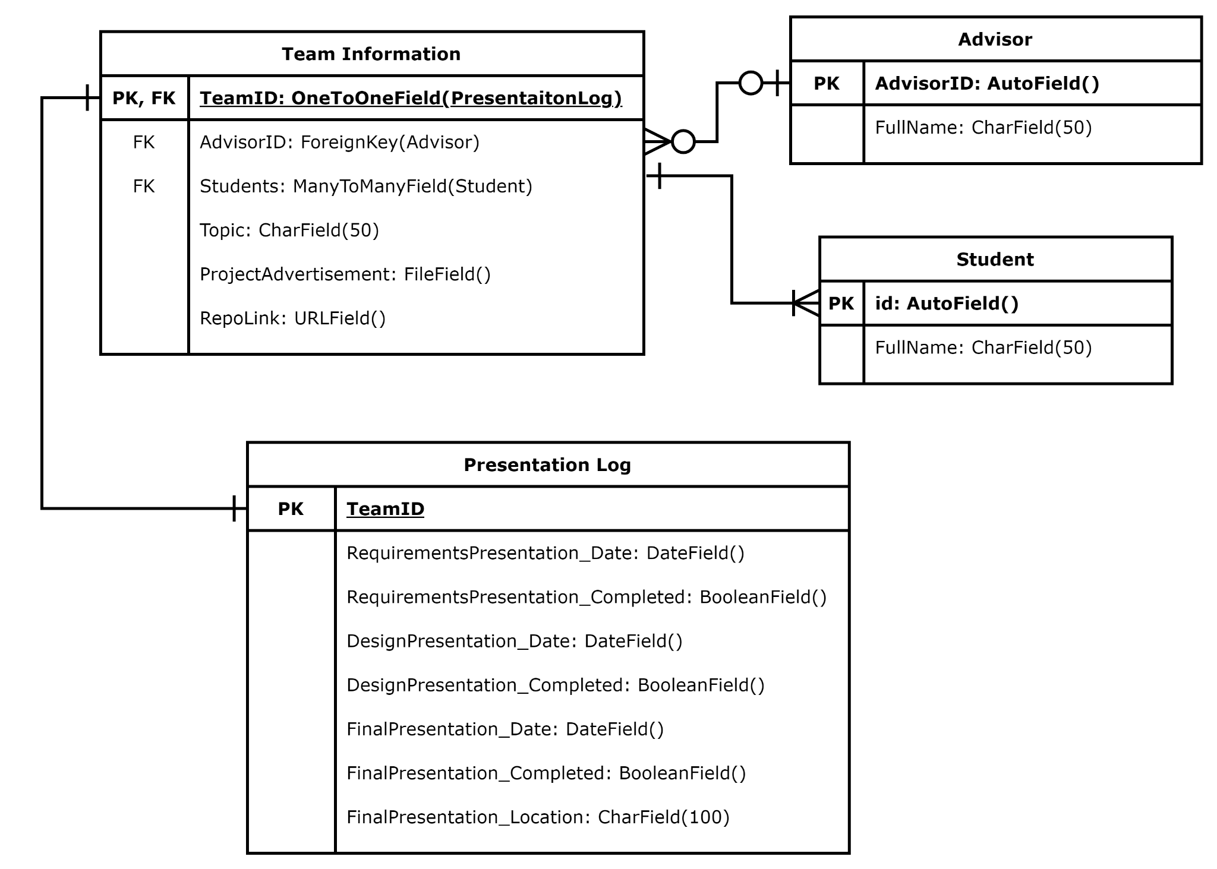
Database Design
Notes:
The database design I went with had 4 tables. An advisor table that holds all the advisors along with an unique identifier and their full name. A student table would hold all the students with similar data held for advisors. A team information table that holds a unique team identifies, the teams advisor, the students that are a part of the team, the teams project topic, their project advertisement stored as a image file, and a repository link that would would provide a link to where all their project information would be held. For the relationships between the tables, a Team information object can have one presentation log, one of more students on a team, and one or no advisors.

Slide 10
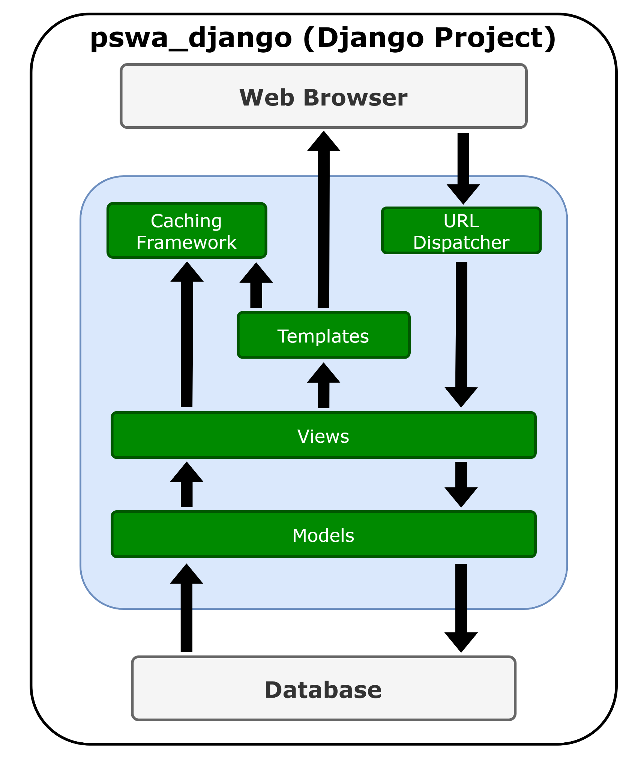
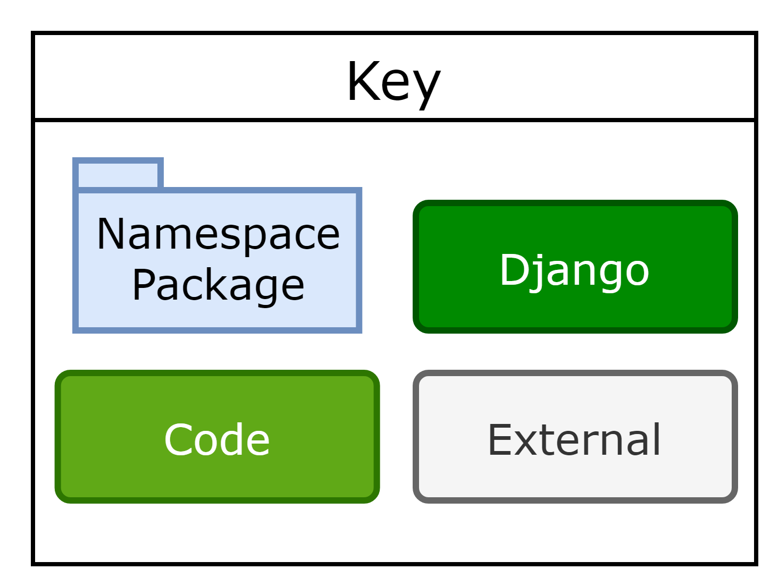
Workflow
Notes:
Now i will talk about my project’s workflow. The workflow of Django is how components interact with each other and make Django a powerful Web Development Framework. I will cover all but django’s caching framework as Django comes with a robust cache system that lets you store the dynamic pages so that they don’t have to be calculated after these sophisticated process each time. I will go from Web Browser downward until we get to Database. So the order I will go in is URL Dispatcher, Templates, Views, and then Models. I will not go over Web Browser or Database as we have already gone over the database design and I will show the web browser in a demo later in this presentation. Before I move on, I used two namespace packages. One being pswa-django which is responsible for alot of the backend work and two being mainForm that does alot of the front end work.

Slide 11
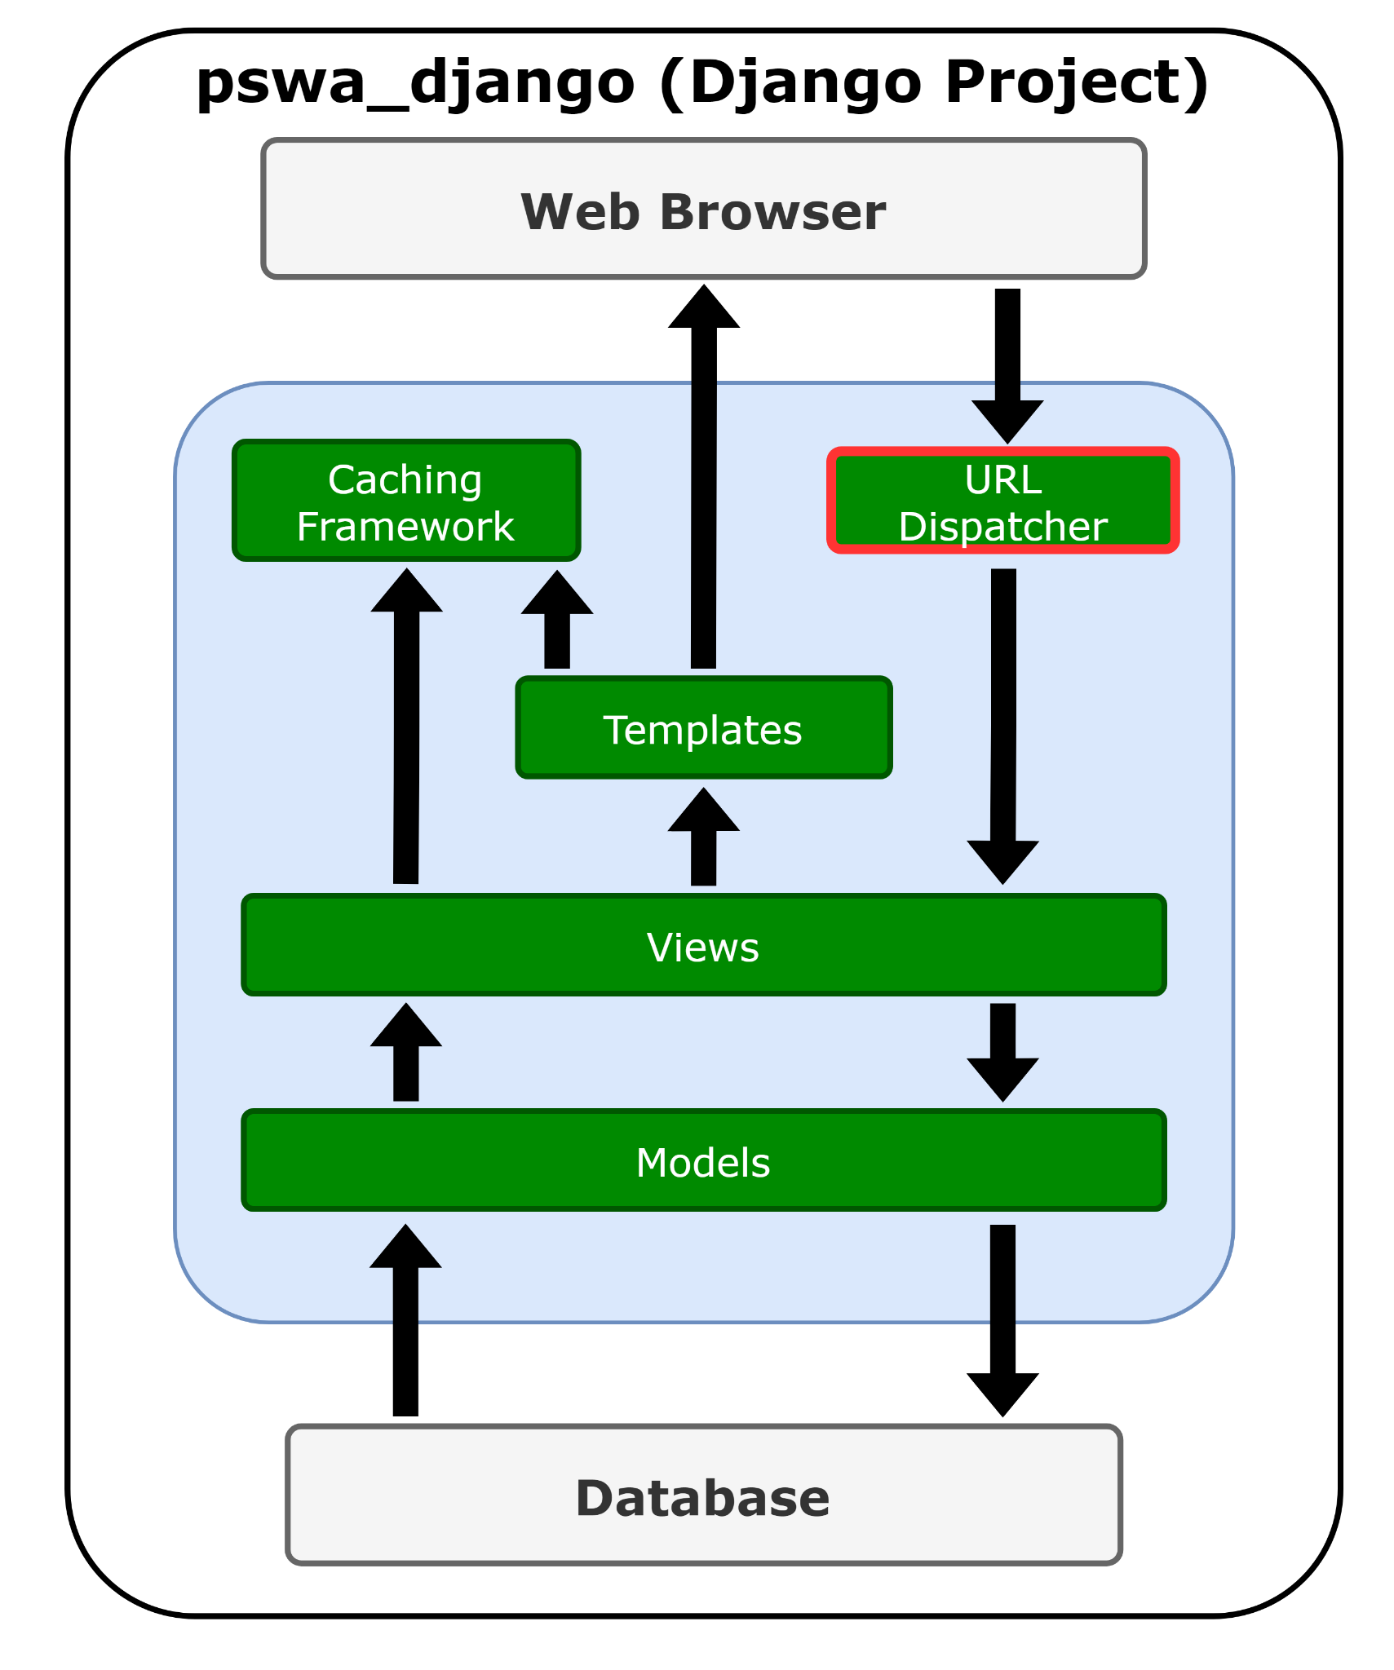
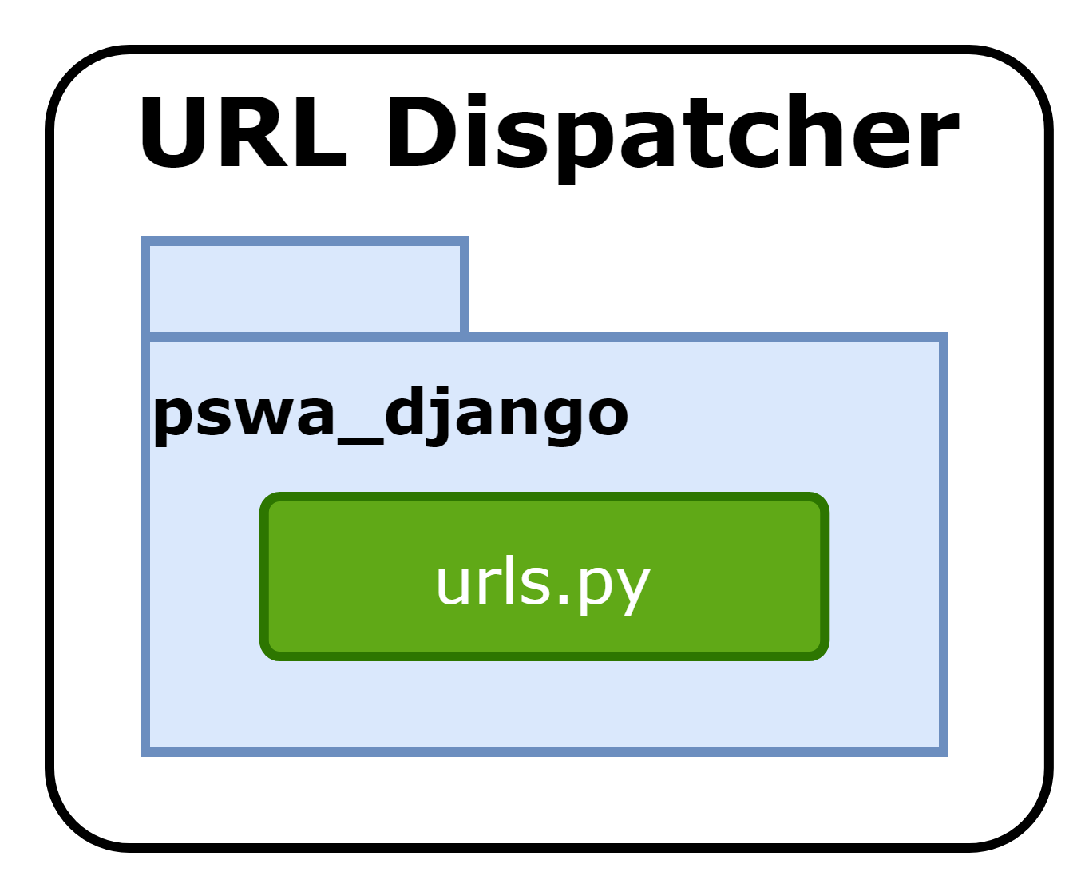
Notes:
We will start with url dispatcher.This is a provided by django and gets user requests by URL locator and responds back to it. django.urls module is used by it to manage the URL’s requests. The urls.py is responsible for mapping between URL path expressions to some specified view. Urls.py is found under the pswa_django namespace package.

Slide 12
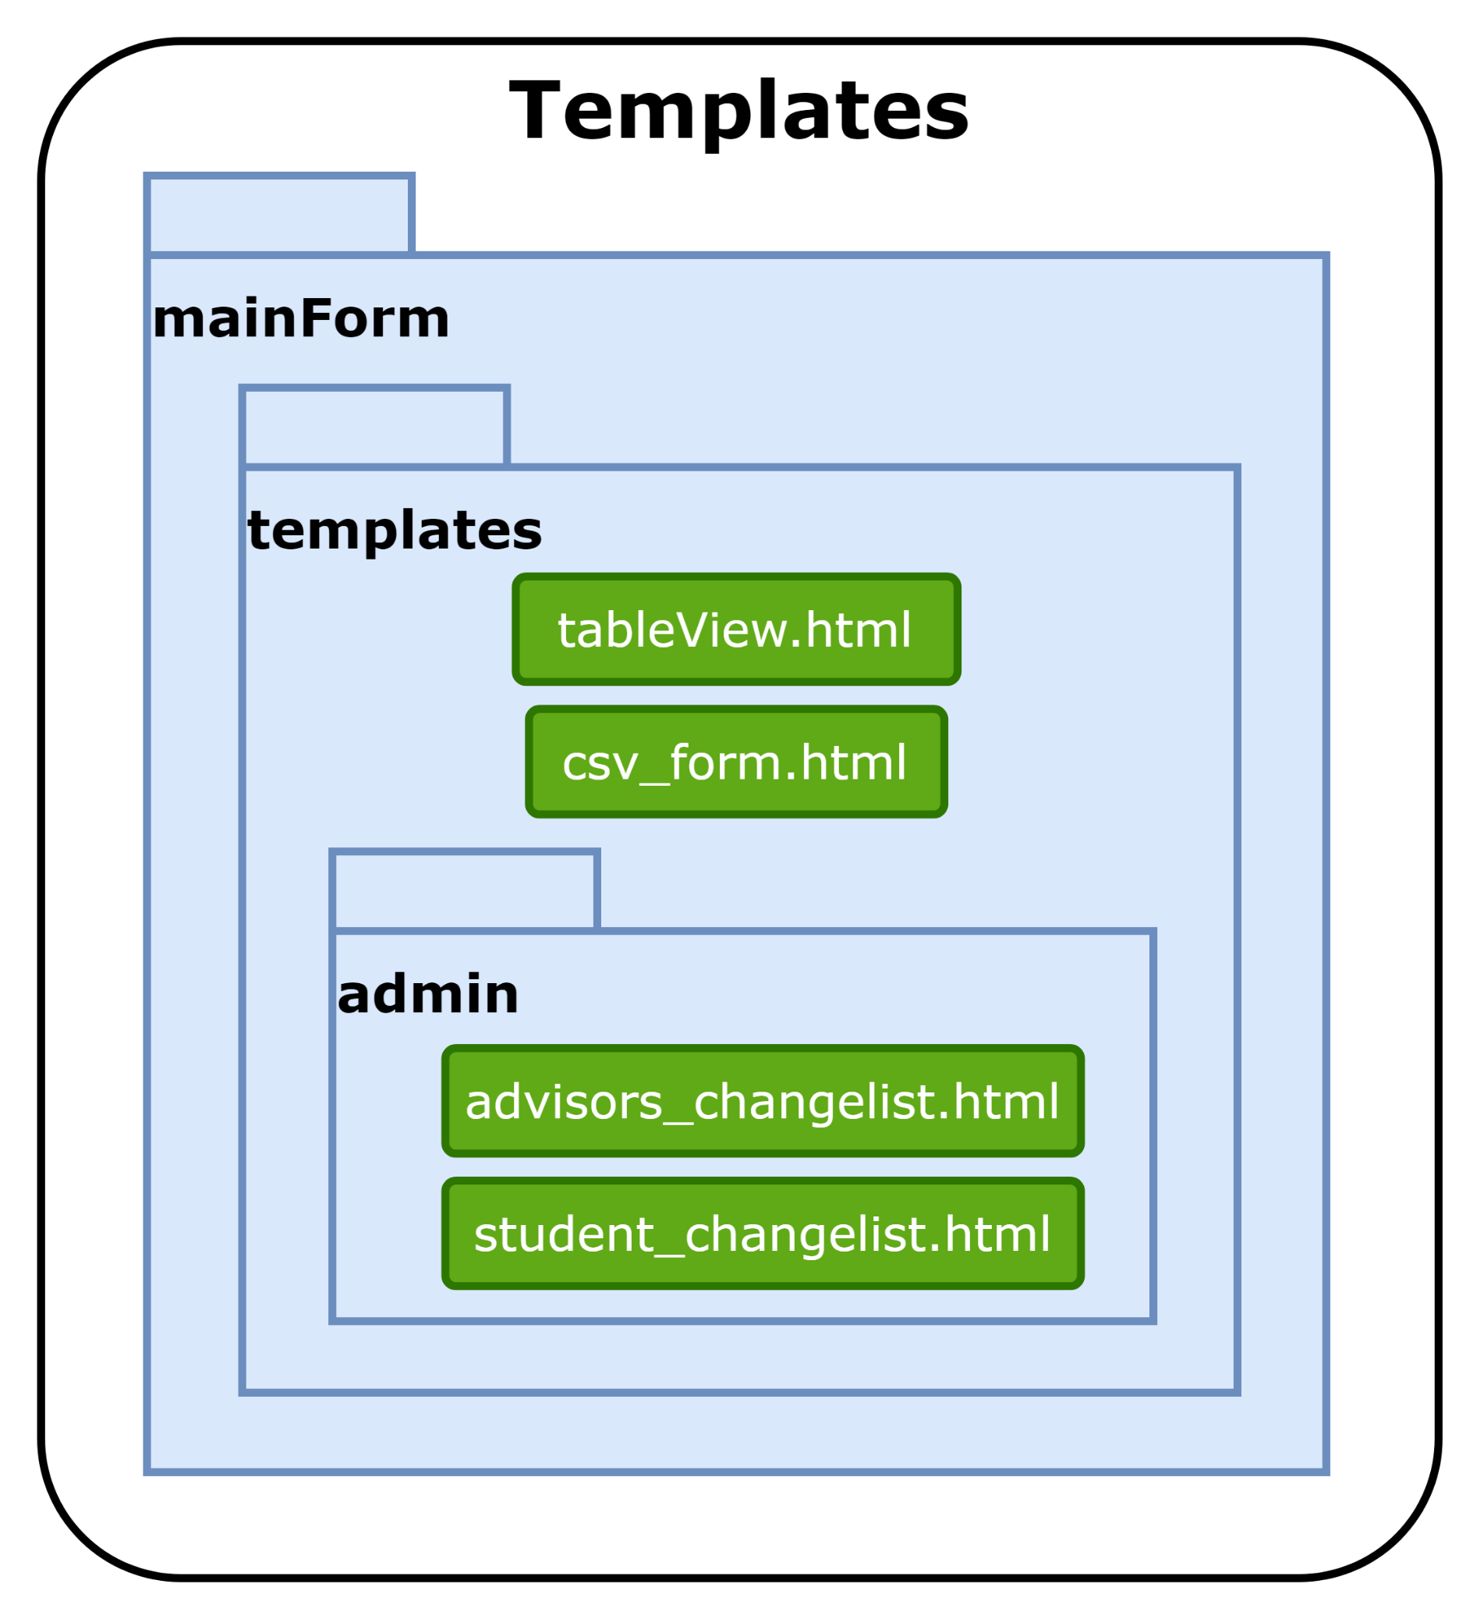

Notes:
Next is Templates. Django already provides template system which helps to distinguish between python and html contents. Dynamic HTML pages are generated by using template system. The templates are found under the mainForm namespace package. The templates and admin are inside of the main namespace and are used to separate different uses. For example admin templates are used for the admin page and any other templates are used in the base site.

Slide 13

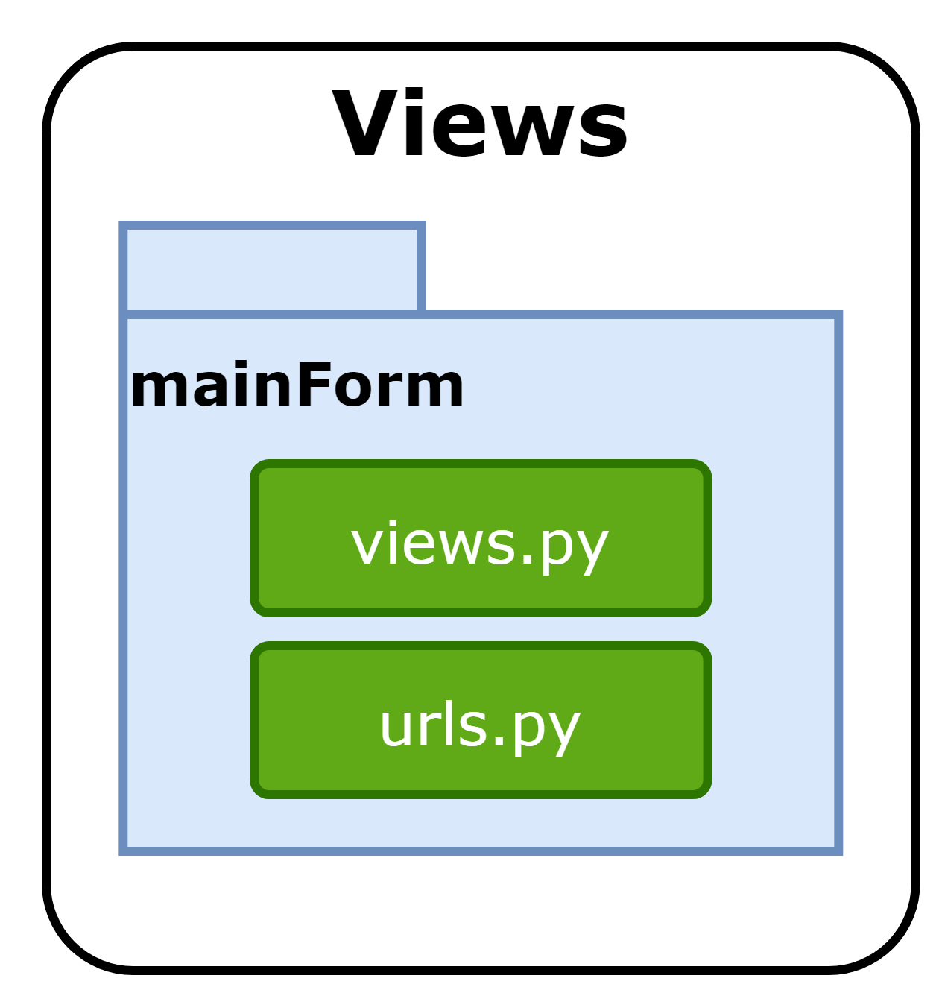
Notes:
Now onto Views. A view is a part of a web application, which is a Python function responsible for accepting a web requests and returning corresponding web response to it. It is a part of our application where main logic of our application is written there, remember that you have to link view to URL to see it as web page

Slide 14
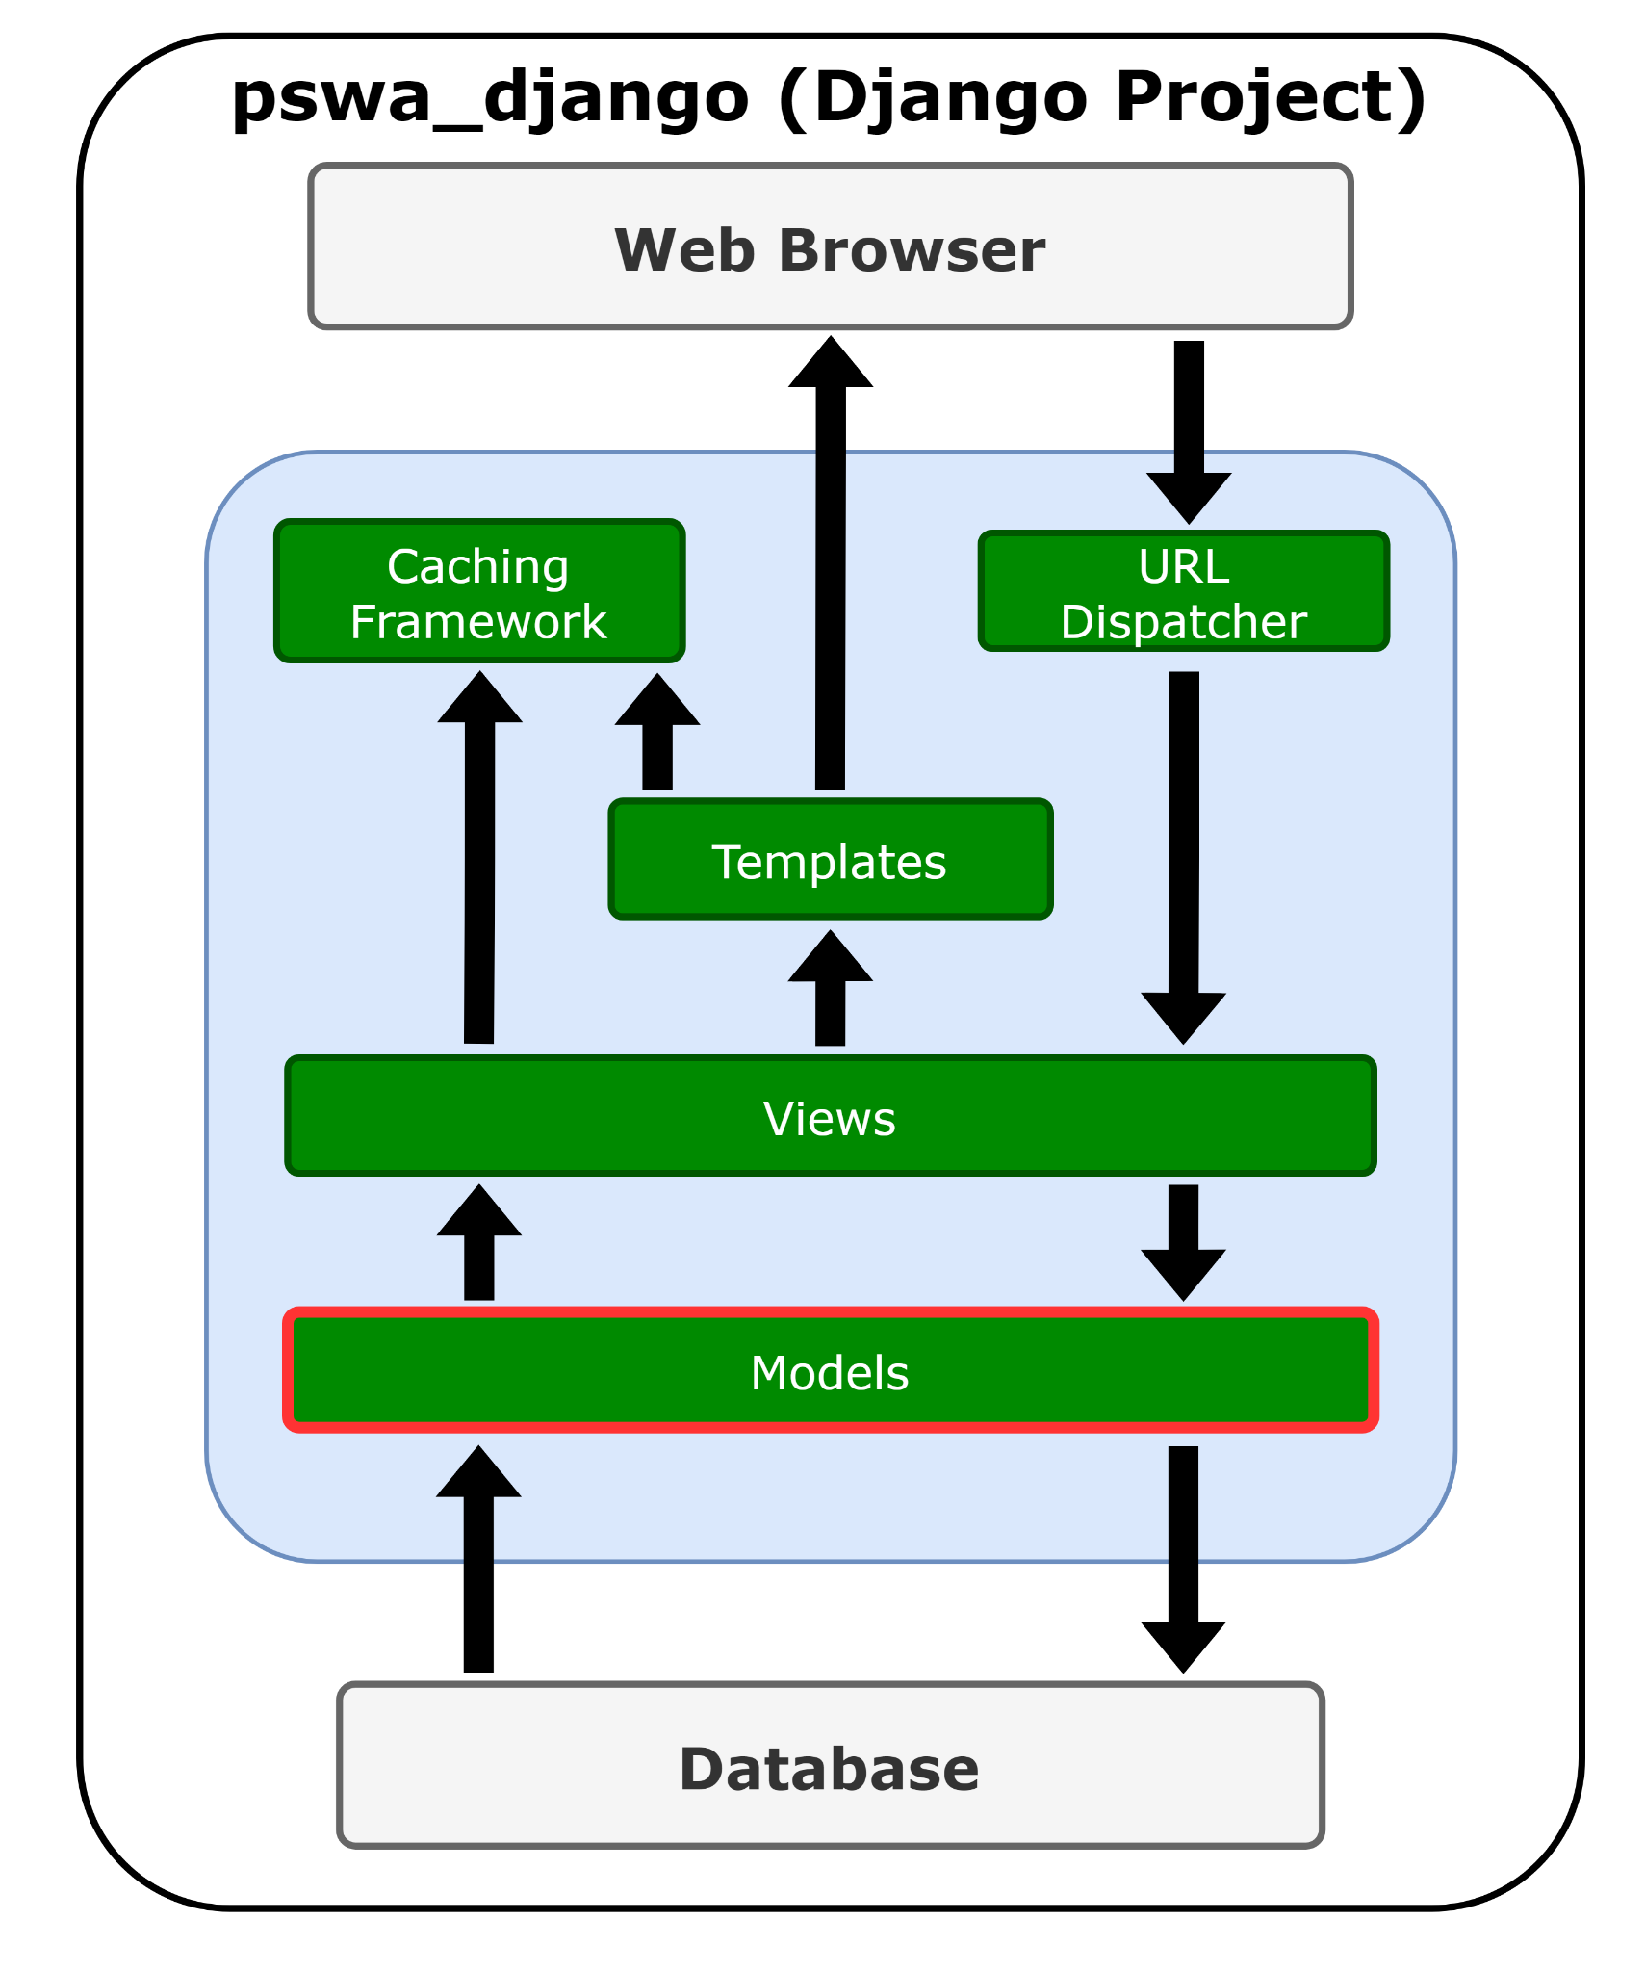
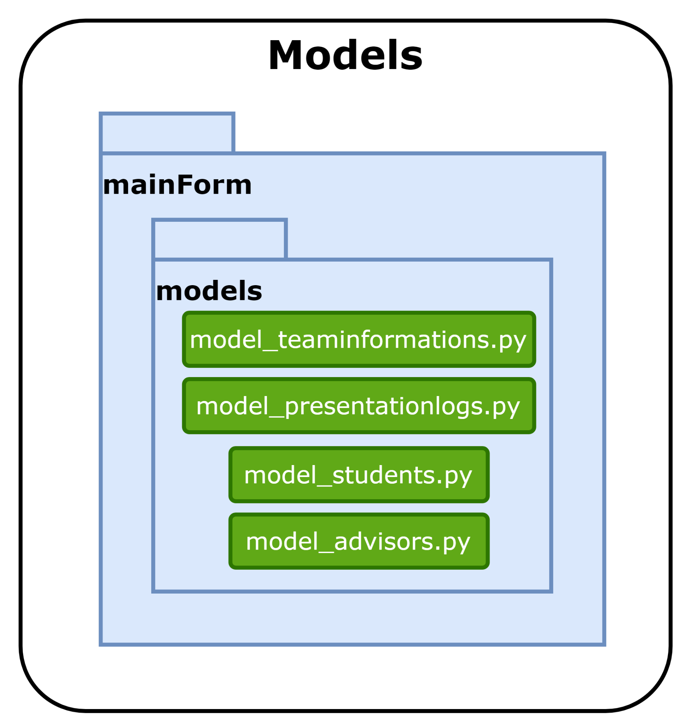
Notes:
Lastly we have models. Django model is a class which contains certain fields and methods and every attribute of class is field of database table. Models are described in respective applications as app_name/models.py or for organization I made a folder for models under the mainForm namespace where each model class is mapped to single table of your database . Whatever field that is created in the model it will added to the database automatically , thereby reducing extra line of codes for creating table in database.

Slide 15
Testing
Designed Unit Tests around models
Minimal Integration Testing
Usability Testing
Easy to Use
Behaves as Expected
Simple Navigation
Notes:
For testing, I did the usual unit tests for models as models are the main components that are used. I did little integration testing as I ran out of time in the project. The reason I had such little time to do integration testing was because I mainly focused on manual testing. The type of manual testing I used was Black Box testing and Usability testing. Black Box testing focuses on the project’s specification and if the software did what it was claimed to do. For usability testing, mainly checking if the software was easy to use, behaved as one would expect, and navigation was simple

Slide 16
Website Demo
Website Link

Slide 17


Initial Requirements Evaluation
Be able to schedule first, second, and final presentation
Have limitation for number of students that can present each date. ex 5
Have a way to provide link to github repository
Way to upload advertisements for final presentation
Presentations are emailed to front office also ~csoffice@cs.ksu.edu
Possible user registration for authentication and start with shadow password
Notes:
Removed the limitation for scheduling presentation on certain dates because if there wasn’t enough time during our weekly monday meetings they would just be moved to the next week.
Added ability to upload advertisement images near the end of the project so I didn’t end up having enough time to add the email to front office functionality. All the website would do for that is store the file so it is easily accessible.
Scrapped the user registration and decided to focus on the admin functionality as they would be the main users for the website.

Slide 18
Modified Requirements Evaluation
Initially Implement for Admin Use
Quality of Life Improvements:
Dropdown List of Advisors
Date Picker for Presentations,
Able to Mark Presentations as Complete,
Easy to Add/Remove Students to/from Teams
Notes:
The admin user has full functionality.

Slide 19
Initial Stretch Goals Evaluation
Drag and drop ability to make it easier to create teams
Drop down list of all possible advisors
Prompting tool to get students going
Auto send email if not done in certain timeframe
Mobile access to web app

Slide 20
Modified Stretch Goals Evaluation
User Registration for Students
Students can Request/Make Changes for Their Team’s Information
Notes:
I decided to focus on the admin user functionality so User Registration for students was on the back burner. With that, there was no student users made from registration so unless they were registered as an admin they are unable to add/modify anything.

Slide 21
Lines of Code Analytics
Application/Frontend (mainForm): 809
Models: 84
Templates: 247
Tests: 80
Admin: 373
Apps.py: 3
Urls.py: 5
Views.py: 17
Backend (pswa_django): 37
Settings: 23
Urls: 10
WSGI: 4
Notes:
Onto some analytics of my project, starting with analyzing how many lines of code were in different namespaces. The two namespaces that I used were mainForm, which was mainly for the front end work, and pswa_django, which dealt with the backend of the project. The exact numbers are listed on the page for both. Mainform ended up having 809 lines of code which makes sense as a main part of any website is what the user sees. Mainform also held the bulk of the functionality and aesthetics of the website. Pswa_django had 37 lines of code as a lot ofthe backend work like connecting to the database and handling the website side of things were done for me by Django at the start.

Slide 22
Total Lines of Code:
846
Notes:
In total, I wrote 846 lines of code for this project. This number alone doesn’t say a whole lot as it only takes into account, well, how much code I wrote. Now what will be interesting to see is how much time I spent on the project.

Slide 23
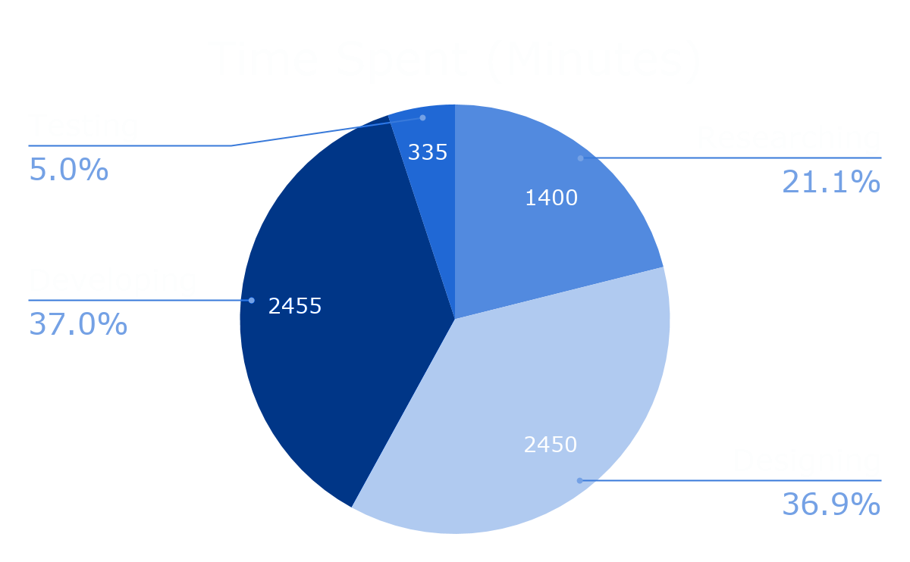
Time Tracker Analytics
Time Totals:
Researching: 23 h 20 m
Designing: 1d 16h 50m
Developing: 1d 16h 55m
Testing: 5h 35m
Overall Total: 4 days 14 hours 40 minutes
6640 Minutes
Notes:
Conveniently, I kept track of how long I spend on the project since its start and made a little pie chart to help visualize the numbers. I decided to the time up into different categories which were researching (how much time I spend online looking at wiki’s and things of that sort), designing (how long it took for me to figure out how to set up the database, how I wanted the website be designed, and of course how I wanted to organize the project), developing (actually making the website satisfy the project requirements and behave as intended), and finally testing (which was unit testing, usability testing, and integration testing. Looking at the neat pie chart on the slide, I ended up spending most of my time designing and developing the program. Interestingly enough, I pretty much spent the same amount of time designing as I did developing. I spent the least amount of time testing which was also interesting to look at. Lastly, research was in the middle and I will say I though I spent alot more time looking things up online as I started out knowing a little about Python and nothing about Django.

Slide 24
6640 Minutes
~ 110.67 Hours
Total Time Spent:
4 days 14 hours 40 minutes
Notes:
In total, I spent around 4 days 14 hours and 40 minutes on this project. That converts to 6,640 Minutes and around 110.67 hours. I spent around 4 and a half days sitting at my computer coding for this project. Don’t worry, I didn't do all this in one sitting. In all seriousness, it can hard to imagine how long this truly is if you have not experienced working on a massive project like this, but I had to manage this while taking 3 other classes and I definitely had less freetime this semester due to this project. Now that I have shown how many lines of code I wrote and how long I spent on this project, I will now go over how many lines of code I wrote per hour on average.

Slide 25
846 Lines of Code
~ 110.67 Hours Spent
846/110.67 = 7.6443
~ 7.65 Lines of Code per Hour
Notes:
Restating previous information, I wrote 846 lines of code and that took me around 110.67 hours. Both of these numbers alone might not mean much, but together they bring insight. Doing a simple calculation, I arrived at 7.65 lines of code per hour. This is taking into account ever single line of code I types and all the time put into research, design, development, and testing.

Slide 26
Review
Motivation Behind Project
Initial Requirements and Stretch Goals
Modified Requirements and Stretch Goals
Tools Used
Database Design
Workflow
Testing
Demo of Website
Evaluation of Requirements and Stretch Goals
Project Analytics
Notes:
Initial requrements then modified requirements and if I achieved them.

Slide 27
Questions?

